Slide 1


Module 3 - Web Designing
Disclaimer: The content is curated for educational purposes only.

Slide 2
Able to Design and Develop Dynamic Websites with PHP
Disclaimer: The content is curated for educational purposes only.

Slide 3
In this section, we will discuss:
Introduction to PHP Script
Looping statement in PHPScript
Working with Predefinedfunctions
PHP files
PHP cookies
PHP sessions
Generating Images with PHP
PHP Form validation
PHP Date and Time
PHP Mouse Events
PHP OOP
PHP Debugging

Slide 4

Introduction to PHP Script
What is PHP?
PHP is an acronym for "PHP: Hypertext Preprocessor"
PHP is a widely-used, open source scripting language
PHP scripts are executed on the server
PHP is free to download and use
Image Source: https://www.cloudways.com/blog/best-php-frameworks/
●
Notes:
References - https://www.w3schools.com/php/php_intro.asp

Slide 5
Introduction to PHP Script
What is a PHP File?
PHP files can contain text, HTML, CSS, JavaScript, and PHP code
PHP code is executed on the server, and the result is returned to the browser as plain HTML
PHP files have extension ".php"
Image Source: https://www.cloudways.com/blog/best-php-frameworks/
●
Notes:
References - https://www.w3schools.com/php/php_intro.asp

Slide 6
Introduction to PHP Script
What Can PHP Do?
PHP can generate dynamic page content
PHP can create, open, read, write, delete, and close files on the server
PHP can collect form data
PHP can send and receive cookies
PHP can add, delete, modify data in your database
PHP can be used to control user-access
PHP can encrypt data
Image Source: https://www.cloudways.com/blog/best-php-frameworks/
●
Notes:
References - https://www.w3schools.com/php/php_intro.asp

Slide 7
Introduction to PHP Script
What PHP?
PHP runs on various platforms (Windows, Linux, Unix, Mac OS X, etc.)
PHP is compatible with almost all servers used today (Apache, IIS, etc.)
PHP supports a wide range of databases
PHP is free. Download it from the official PHP resource: www.php.net
PHP is easy to learn and runs efficiently on the server side
Image Source: https://www.cloudways.com/blog/best-php-frameworks/
●
Notes:
References - https://www.w3schools.com/php/php_intro.asp

Slide 8
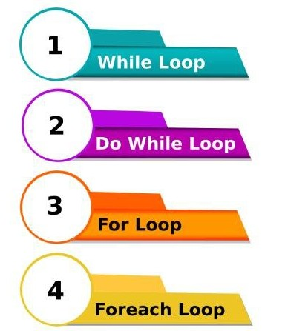
Doing Repetitive task with looping
Loop Statements
Loops are used to execute the same block of code a specified number of times.
There are four types of loops for ,forech
,while and do-while loop.
●
https://cdn.educba.com/academy/wp-content/uploads/2020/02/different-types-of-Loops.jpg

Slide 9
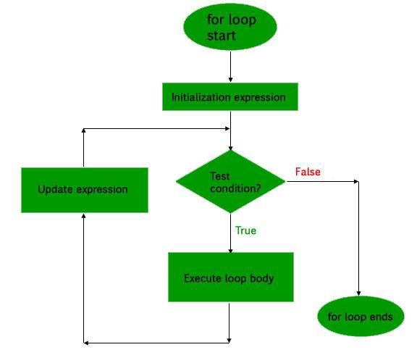
Doing Repetitive task with looping
For Loop
for loop is used when you know how many times you want to execute a statement or a block of statements.
There are three main parameters to the code, namely the initialization, the test condition and the counter.
●
https://www.w3schools.com/php/php_looping_for.asp

Slide 10
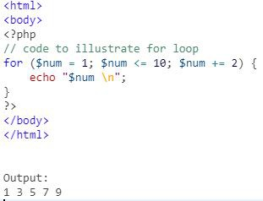
Doing Repetitive task with looping
For Loop (Continued)
Syntax:
for (initialization; condition; increment)
{
code to be executed;
}
●
https://www.geeksforgeeks.org/php-loops/?ref=lbp

Slide 11
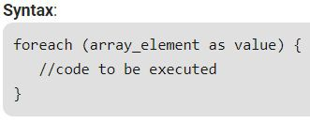
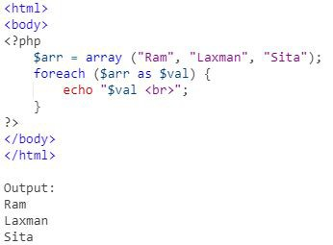
Doing Repetitive task with looping
Foreach Loop
Foreach loop is used to iterate over arrays.
For every counter of loop, an array element is assigned and the next counter is shifted to the next element.
●
https://www.geeksforgeeks.org/php-loops/?ref=lbp

Slide 12
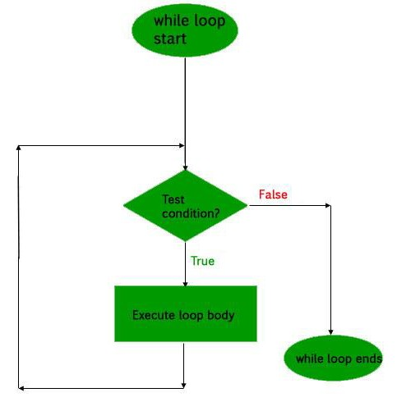
Doing Repetitive task with looping
While Loop
The while loop is also an entry control loop like for loops .
it first checks the condition.
If the condition true true then it enters the loop and executes the block of statements,
●
https://www.geeksforgeeks.org/php-loops/?ref=lbp

Slide 13
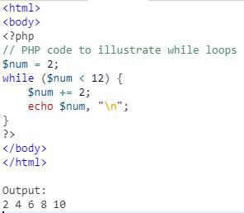
Doing Repetitive task with looping
While Loop (Continued)
Syntax:
while (if the condition is true) {
// code is executed
}
●
https://www.w3schools.com/php/php_looping_while.asp

Slide 14
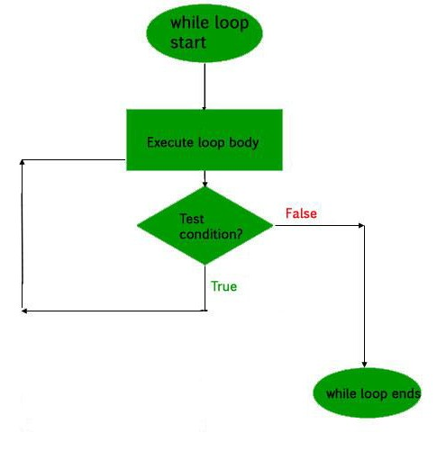
Doing Repetitive task with looping
Do-While Loop
The do-while loop will always execute the block of code once.
It will then check the condition, and repeat the loop while the specified condition is true.
●
https://www.w3schools.com/php/php_looping_while.asp

Slide 15
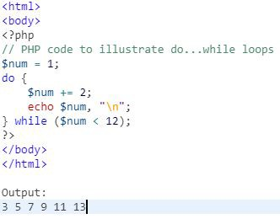
Doing Repetitive task with looping
Do-While Loop (Continued)
Syntax:
do {
//code is executed
} while (if condition is true);
●
https://www.w3schools.com/php/php_looping_while.asp

Slide 16
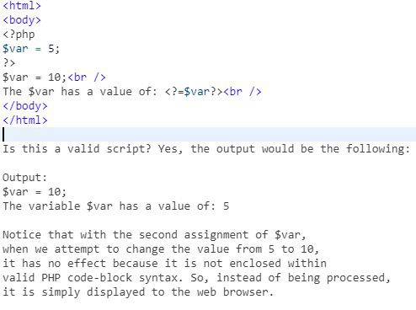
Mixing Decisions and looping with Html
Mixing Decisions and looping with Html
PHP will only processes things that are enclosed within one of its valid code blocks (such as <?php and ?>).
PHP effectively ignores everything that it was not specifically told to process
●
http://shubhneet.com/mixing-decisions-and-looping-with-html/

Slide 17
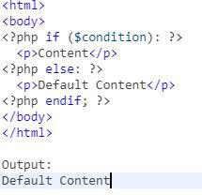
Mixing Decisions and looping with Html
PHP Conditions with HTML
Display a certain HTML code if the condition is true in PHP
PHP Condition is being used simply to control the output of standard HTML code
●
http://shubhneet.com/mixing-decisions-and-looping-with-html/

Slide 18
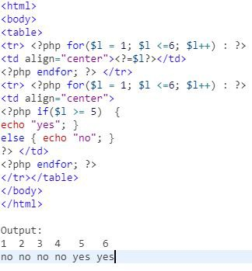
Mixing Decisions and looping with Html
Embedded Syntax in HTML
Beyond simple if statements, most control structures provide an alternative syntax .
That allows us to embed PHP code within standard HTML quickly and easily.
●
http://shubhneet.com/mixing-decisions-and-looping-with-html/

Slide 19
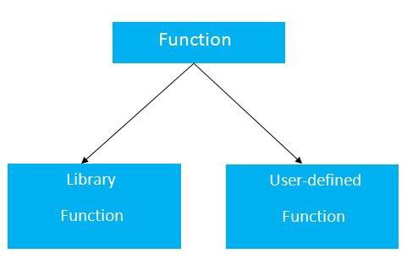
Function
https://static.javatpoint.com/cpages/images/c-function.jpg

Slide 20
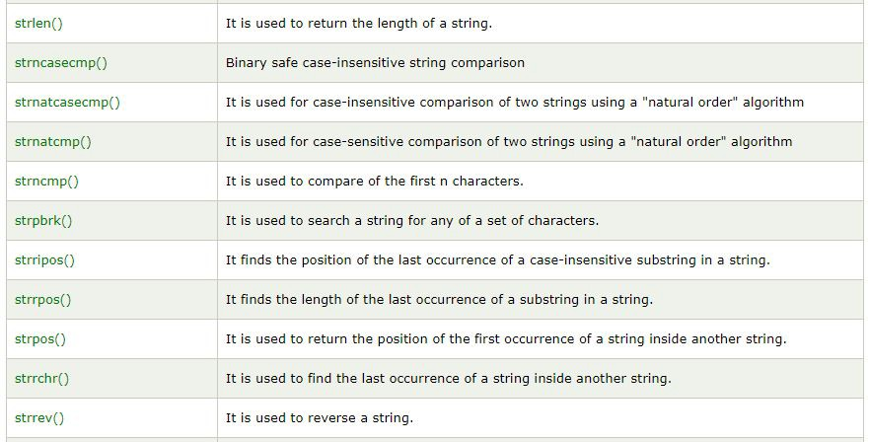
Function - What is a function?
Built-in Functions
The functions are also called as Library or Standard functions.
These functions are provided by the programmer.
We can use the functions directly.
Ex:echo(),sort(),print(),sprint(),..etc
●
https://www.javatpoint.com/php-string-functions

Slide 21
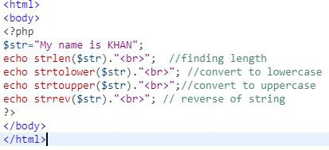
Function - What is a function?
Built-in Functions (Continued..)
The following library functions used for strings operations.
strrev()
strlen()
Strtolower()
Strtoupper()
echo()
●
https://www.javatpoint.com/php-string-functions

Slide 22
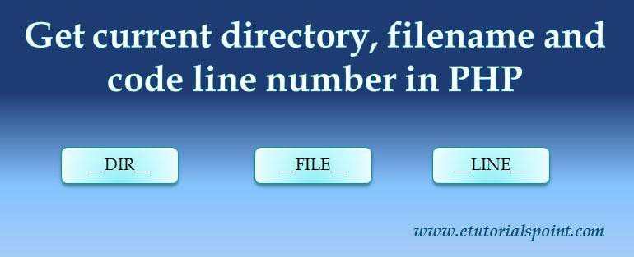
Working with File and Directories – Understanding File & Directory
Image Source:
https://www.etutorialspoint.com/index.php/16-how-to-get-current-filename-directory-linenumber-in-php

Slide 23
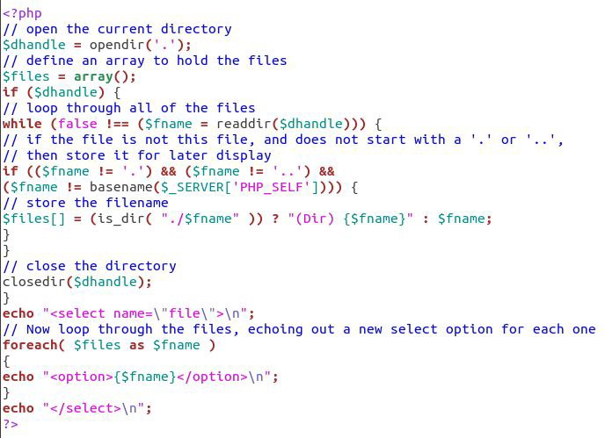
Working with File and Directories – Understanding File & Directory
Reading the Contents of a Directory
Three functions to perform this task: opendir(), readdir() and closedir().
Note that readdir() returns only the names of its items, rather than full paths.

Slide 24
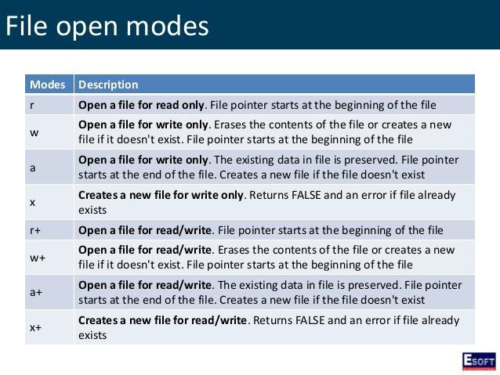
Working with File and Directories – Understanding File & Directory
File Opening Modes
A file can be opened in read-only mode or in reading and write modes.
Image Source: https://www.slideshare.net

Slide 25
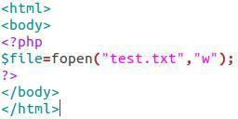
Opening and closing a file
Opening a File
To open a file PHP you can use the fopen() function.
This function takes two parameters, where the first parameter contains the name of the file and the second parameter is the mode that should be used to open the file.

Slide 26
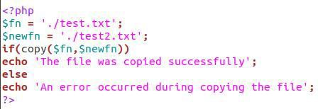
Copying, renaming and deleting a file
PHP copying a file
To copy a file, you use the copy() function.
The copy() function returns true if the file was copied successfully, otherwise, it returns false.

Slide 27
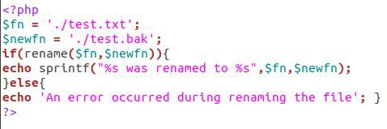
Coping, renaming and deleting a file
PHP renaming a file
To rename a file, you use the rename () function.
This function also allows you to move a
file to a different directory.

Slide 28
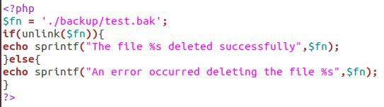
Coping, renaming and deleting a file
PHP deleting a file
To delete a file, you use the unlink() function.
You need to pass the file name that you want to delete to the unlink() function.
The function returns true on success or false on failure.

Slide 29
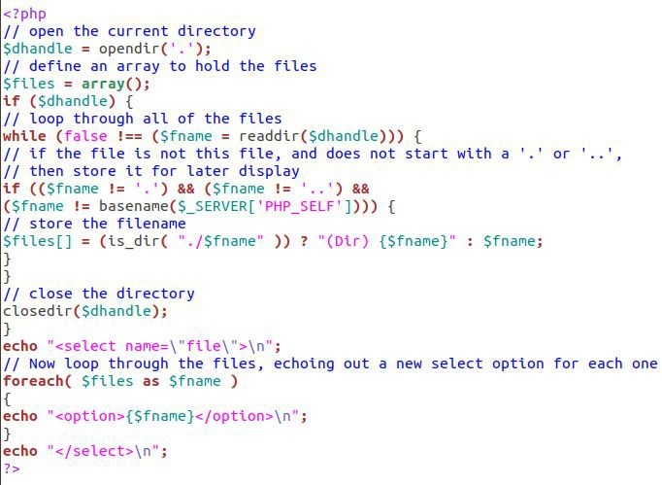
Working with directories
Reading the Contents of a Directory
Three functions to perform this task: opendir(), readdir() and closedir().
Note that readdir() returns only the names of its items, rather than full paths.

Slide 30

Working with directories
Deleting the Directory and Its Contents
PHP has the rmdir( ) function that takes a directory name as its only parameter.
It will remove the specified directory from the file system if the process running your script has the right to do so.
However, the rmdir() function works only on empty directories.

Slide 31
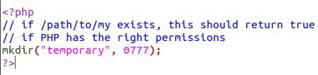
Working with directories
Creating New Directories
Using the mkdir() function, which takes
two parameters.
These parameters are, in order, a directory name you want to create and a
permission mode for a new directory, which must be an octal number.
The mode parameter is optional and has an effect only on Unix systems.

Slide 32
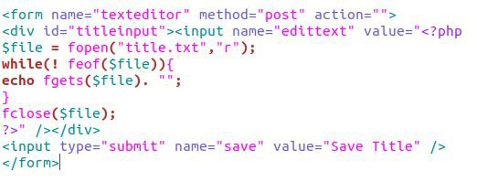
Text editor File
© Edunet Foundation. All rights reserved.

Slide 33
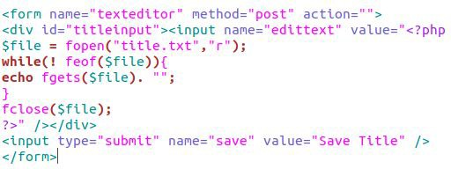
Building a text editor File Uploading & Downloading
Building a text editor File
The first thing that must be done is define the file(s).
An array is used so that both files can be identified and called through $files and later through the $file.
A value is being defined which will help pull the text from the respective submit buttons in the form fields.

Slide 34
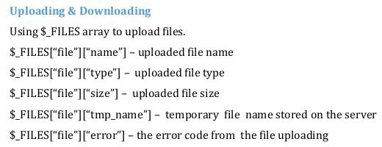
Building a text editor File Uploading & Downloading
Upload a file to server
$_FILES array is used to upload files.
Image Source:
https://www.etutorialspoint.com/index.php/16-how-to-get-current-filename-director

Slide 35

Building a text editor File Uploading & Downloading
Download files in PHP
The Content-Disposition header function is used in PHP to supply a recommended filename and force the browser to display the save dialog.
Before downloading the files, file types are checked.
Image Source: https://www.tutorialexample.com

Slide 36

Using query string (URL rewriting)
Passing a query string to a page
There are two ways to pass a QueryString to a page, the first is to enter it manually.
An alternative, and perhaps more useful, the way is to use HTML forms.
The main thing to remember with forms is that you need to use the GET method to send information via the query string.

Slide 37
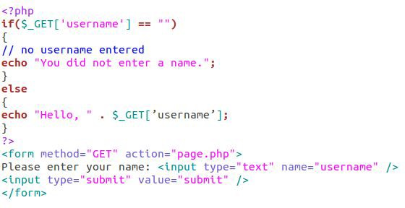
Using query string (URL rewriting)
Accessing a query string element in a PHP page
In PHP, all the information passed via the query string is held in the $_GET super global array.
To access an item, type
$_GET[‘varName’], where varName is the name of the variable in the query string.

Slide 38
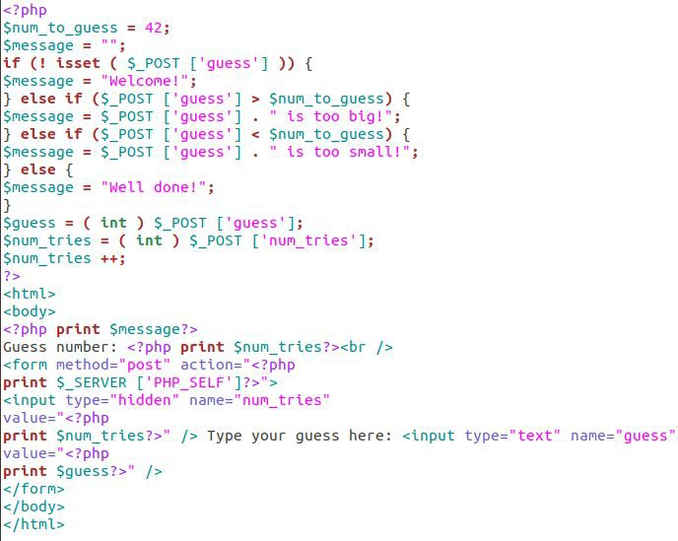
Using Hidden field
Using Hidden field
A hidden field is not shown on the page.
It simply keeps the text value specified in the value attribute.
Hidden fields are good for passing additional information from the form to the server.

Slide 39

Using cookies
Using cookies, The Anatomy of a cookie
Cookies are text files stored on the client computer and they are kept of use tracking purpose.
PHP transparently supports HTTP cookies.
Cookies are usually set in an HTTP header.
Image Source: https://www.sitesbay.com/php/php-cookies-in-php

Slide 40
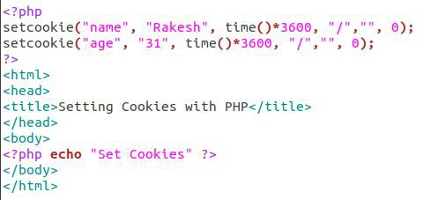
Using cookies
Setting Cookies with PHP
PHP provided setcookie() function to set a cookie.
This function requires up to six arguments and should be called before
<html> tag.
For each cookie, this function has to be
called separately.

Slide 41
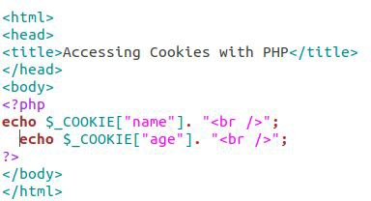
Using cookies
Accessing Cookies with PHP
PHP provides many ways to access cookies. The simplest way is to use is
$_COOKIE variables.

Slide 42
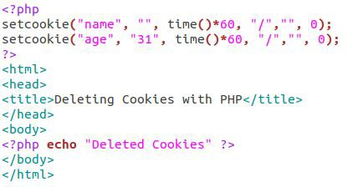
Using cookies
Deleting Cookie with PHP
To delete a cookie you should call setcookie() with the name argument only.
It is safest to set the cookie with a date that has already expired.

Slide 43
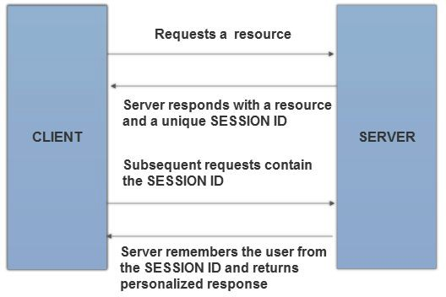
Using session
Using Session
An alternative way to make data accessible across the various pages of an entire website is to use a PHP Session.
A session creates a file in a temporary directory on the server where registered session variables and their values are stored.
Image Source: http://phpdeveloper.org

Slide 44
Using session
Starting a PHP Session
The session_start () function is used to start a PHP session.
It is recommended to put the call to session_start () at the beginning of the page.
Image Source: http://phpdeveloper.org

Slide 45
Using session
Destroying a PHP Session
A PHP session can be destroyed by session_destroy() function.
to destroy a single session variable, unset() function is used to unset a session variable.
Image Source: http://phpdeveloper.org

Slide 46
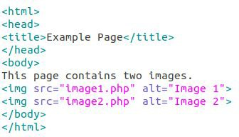
Generating Images with PHP
Embedding an Image in a Page
A standard web page containing text and graphics is created through a series of HTTP requests from the web browser, each answered by a response from the web server.

Slide 47
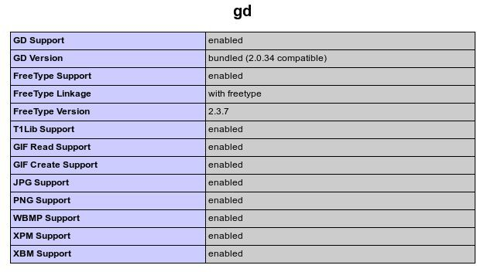
Generating Images with PHP
The GD Extension
GD extension allows PHP to use the open source GD graphics library available from http://www.boutell.com/gd/.
Image Source: https://jpgraph.net/download/manuals/chunkhtml/ch03s02.html

Slide 48
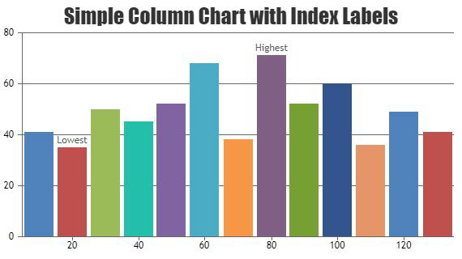
Basics of computer Graphics
Image Source: https://canvasjs.com/php-charts/
© Edunet Foundation. All rights reserved.

Slide 49
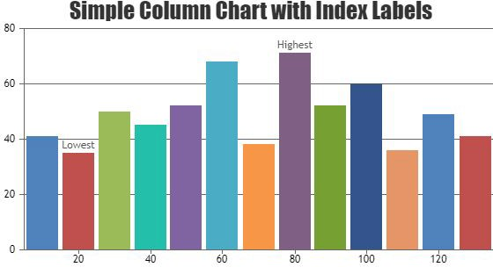
Basics of computer Graphics
Basic Graphics Concepts
An image is a rectangle of pixels that have various colors.
Colors are identified by their position in the palette, an array of colors.
Each entry in the palette has three separate color values—one for red, one for green, and one for blue. Each value ranges from 0 (this color not present) to 255 (this color at full intensity).
Image Source: https://canvasjs.com/php-charts/

Slide 50

Creating Image
Creating An Image with the PHP GD Library
The three standard type of images that can be created from scratch with the PHP GD Library is JPG, GIF, and PNG.
Different image functions are used from the GD library to create image.

Slide 51
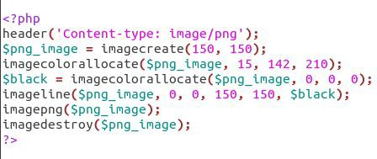
Manipulating Image
How to Draw Lines on an Image
The imageline() function itself requires 6 parameters. The syntax is: imageline(image, x1,y1, x2, y2, color)
image = Refers to the Image Resource That the Line Will Be Applied to.

Slide 52
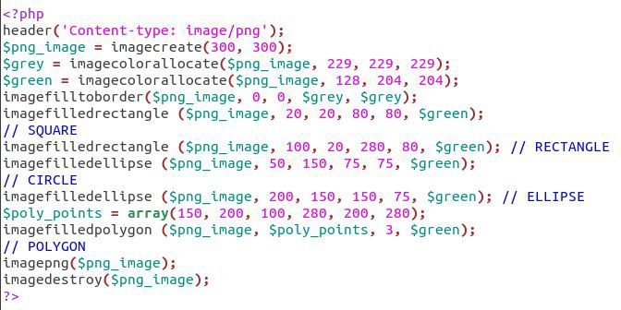
Manipulating Image
How to Draw Shapes On An Image
Use the imagefilledrectangle() function to draw squares and rectangles, specifying the top left and bottom right corner positions.
Use the imagefilledellipse() function to draw circles and ellipses, specifying the center position, width, and height of the shape.
Use the imagefilledpolygon() function to draw polygons, specifying the three point of the shape, and few more.

Slide 53
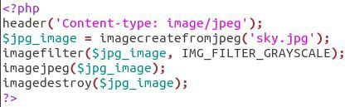
Manipulating Image
How to Add Image Filters & Effects
The imagefilter() function can be used to apply various fun and/or useful effects to an existing image or photograph.

Slide 54
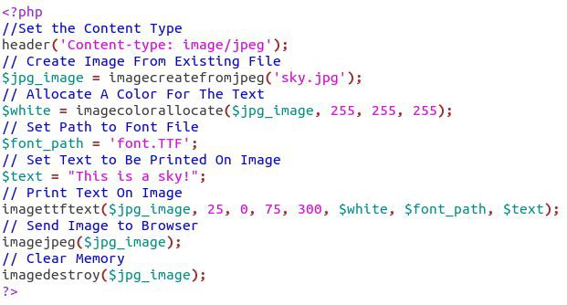
Using text in Image
Using text in Image
To add text to an image, you need two things: the image and the font.
Three functions are used to create an image from an existing image so that it can be used/edited.

Slide 55
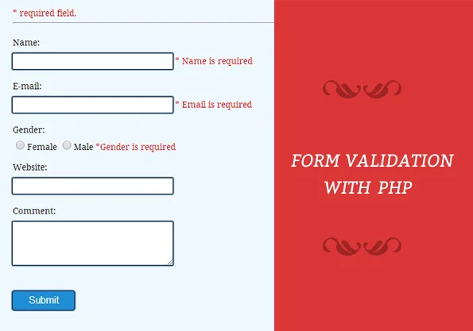
PHP Form Validation
What is Form Validation?
Form validation is a technical process where a web-form checks if the information provided by a user is correct.
The form will either alert the user that they messed up and need to fix something to proceed, or
The form will be validated and the user will be able to continue with their registration process.
Image Source: https://www.formget.com/form-validation-using-php/
Notes:
References - https://cxl.com/blog/form-validation/

Slide 56
PHP Form Validation
What is Form Validation?
There are two types of validation are available in PHP.
Client-Side Validation − Validation is performed on the client machine web browsers.
Server Side Validation − After submitted by data, The data has sent to a server and perform validation checks in server machine.
Image Source: https://www.formget.com/form-validation-using-php/
Notes:
References - https://www.tutorialspoint.com/php/php_validation_example.htm#:~:text=Validation%20means%20check%20the%20input,the%20client%20machine%20web%20browsers.

Slide 57
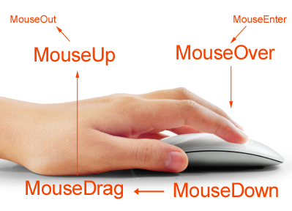
PHP Mouse Events
The MouseEvent Object
Events that occur when the mouse interacts with the HTML document belongs to the MouseEvent Object.
Image Source: https://tycourses.github.io/intro-to-coding/topic06/index.html
Notes:
References - https://www.tutorialspoint.com/php/php_validation_example.htm#:~:text=Validation%20means%20check%20the%20input,the%20client%20machine%20web%20browsers.

Slide 58

PHP Mouse Events
The MouseEvent Object
The MouseEvent inherits all the properties and methods from:
The UiEvent
The Event Object
Image Source: https://tycourses.github.io/intro-to-coding/topic06/index.html
Notes:
References - https://www.tutorialspoint.com/php/php_validation_example.htm#:~:text=Validation%20means%20check%20the%20input,the%20client%20machine%20web%20browsers.

Slide 59
PHP Mouse Events
The MouseEvent Object
The MouseEvent inherits all the properties and methods from:
The UiEvent
The Event Object
Image Source: https://tycourses.github.io/intro-to-coding/topic06/index.html
Notes:
References - https://www.tutorialspoint.com/php/php_validation_example.htm#:~:text=Validation%20means%20check%20the%20input,the%20client%20machine%20web%20browsers.

Slide 60
PHP Mouse Events
Event Types
Onclick
Oncontextmenu
Ondblclick
Onmousedown
Onmouseenter
Onmouseleave
Onmousemove
Onmouseout
Onmouseover
onmouseup
Image Source: https://tycourses.github.io/intro-to-coding/topic06/index.html
Notes:
References - https://www.tutorialspoint.com/php/php_validation_example.htm#:~:text=Validation%20means%20check%20the%20input,the%20client%20machine%20web%20browsers.

Slide 61
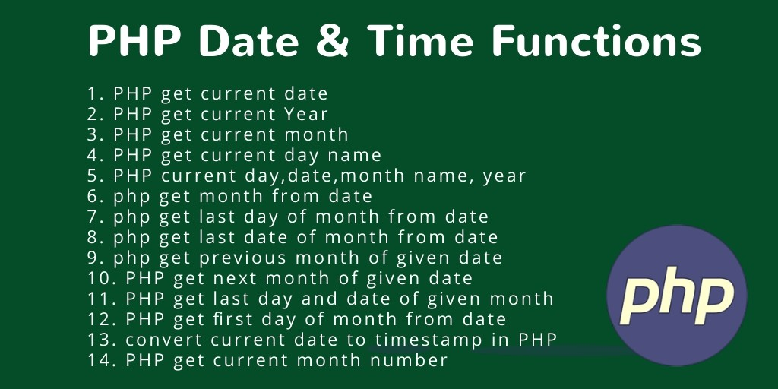
PHP Date and Time
The PHP Date() Function
The PHP date() function formats a timestamp to a more readable date and time.
Syntax - date(format,timestamp)
Format - Required. Specifies the format of the timestamp
Timestamp - Optional. Specifies a timestamp. Default is the current date and time
Image Source: https://www.tutsmake.com/php-functions-date-and-timephp-tutorial/
Notes:
References - https://www.w3schools.com/php/php_date.asp

Slide 62
PHP Date and Time
Get a Date
Here are some characters that are commonly used for dates:
d - Represents the day of the month (01 to 31)
m - Represents a month (01 to 12)
Y - Represents a year (in four digits)
l (lowercase 'L') - Represents the day of the week
Image Source: https://www.tutsmake.com/php-functions-date-and-timephp-tutorial/
Notes:
References - https://www.w3schools.com/php/php_date.asp

Slide 63

PHP - OOP
What is OOP?
From PHP5, you can also write PHP code in an object-oriented style.
Object-Oriented programming is faster and easier to execute.
Procedural programming is about writing procedures or functions that perform operations on the data, while
object-oriented programming is about creating objects that contain both data and functions.
Image Source: https://medium.com/ph-devconnect/object-oriented-php-an-easy-approach-6774c425854a
Notes:
References - https://www.w3schools.com/php/php_oop_what_is.asp

Slide 64
PHP - OOP
What are Classes and Objects?
A class is a template for objects, and an object is an instance of a class.
When the individual objects are created, they inherit all the properties and behaviors from the class, but each object will have different values for the properties.
Image Source: https://medium.com/ph-devconnect/object-oriented-php-an-easy-approach-6774c425854a
Notes:
References - https://www.w3schools.com/php/php_oop_what_is.asp

Slide 65
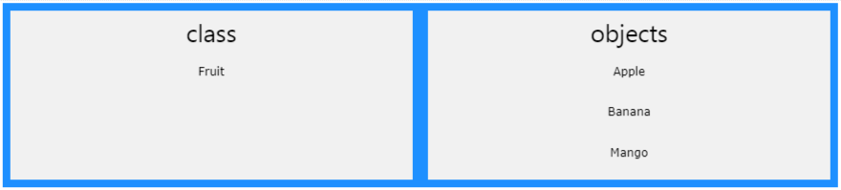
PHP - OOP
What are Classes and Objects?
A class is a template for objects, and an object is an instance of a class.
When the individual objects are created, they inherit all the properties and behaviors from the class, but each object will have different values for the properties.
Image Source: https://www.w3schools.com/php/php_oop_what_is.aspl
Notes:
References - https://www.w3schools.com/php/php_oop_what_is.asp

Slide 66
PHP - OOP
Constructor
The __construct Function
A constructor allows you to initialize an object's properties upon creation of the object.
If you create a __construct() function, PHP will automatically call this function when you create an object from a class.
Notice that the construct function starts with two underscores (__)!
Image Source: https://medium.com/ph-devconnect/object-oriented-php-an-easy-approach-6774c425854a
Notes:
References - https://www.w3schools.com/php/php_oop_what_is.asp

Slide 67
PHP - OOP
Destructor
The __destruct Function
A destructor is called when the object is destructed or the script is stopped or exited.
If you create a __destruct() function, PHP will automatically call this function at the end of the script.
Notice that the destruct function starts with two underscores (__)!
Image Source: https://medium.com/ph-devconnect/object-oriented-php-an-easy-approach-6774c425854a
Notes:
References - https://www.w3schools.com/php/php_oop_what_is.asp

Slide 68
PHP - OOP
Access Modifiers
Properties and methods can have access modifiers which control where they can be accessed.
There are three access modifiers:
public - the property or method can be accessed from everywhere. This is default
protected - the property or method can be accessed within the class and by classes derived from that class
private - the property or method can ONLY be accessed within the class
Image Source: https://medium.com/ph-devconnect/object-oriented-php-an-easy-approach-6774c425854a
Notes:
References - https://www.w3schools.com/php/php_oop_what_is.asp

Slide 69
PHP - OOP
Inheritance
Inheritance in OOP = When a class derives from another class.
The child class will inherit all the public and protected properties and methods from the parent class. In addition, it can have its own properties and methods.
An inherited class is defined by using the extends keyword.
Image Source: https://medium.com/ph-devconnect/object-oriented-php-an-easy-approach-6774c425854a
Notes:
References - https://www.w3schools.com/php/php_oop_what_is.asp

Slide 70
PHP - OOP
Class Constants
Constants cannot be changed once it is declared.
Class constants can be useful if you need to define some constant data within a class.
A class constant is declared inside a class with the const keyword.
Class constants are case-sensitive. However, it is recommended to name the constants in all uppercase letters.
We can access a constant from outside the class by using the class name followed by the scope resolution operator (::) followed by the constant name
Image Source: https://medium.com/ph-devconnect/object-oriented-php-an-easy-approach-6774c425854a
Notes:
References - https://www.w3schools.com/php/php_oop_what_is.asp

Slide 71
PHP - OOP
Abstract Classes
Abstract classes and methods are when the parent class has a named method, but need its child class(es) to fill out the tasks.
An abstract class is a class that contains at least one abstract method. An abstract method is a method that is declared, but not implemented in the code.
An abstract class or method is defined with the abstract keyword:
Image Source: https://medium.com/ph-devconnect/object-oriented-php-an-easy-approach-6774c425854a
Notes:
References - https://www.w3schools.com/php/php_oop_what_is.asp

Slide 72
PHP - OOP
Interfaces
Interfaces allow you to specify what methods a class should implement.
Interfaces make it easy to use a variety of different classes in the same way. When one or more classes use the same interface, it is referred to as "polymorphism".
Interfaces are declared with the interface keyword
Image Source: https://medium.com/ph-devconnect/object-oriented-php-an-easy-approach-6774c425854a
Notes:
References - https://www.w3schools.com/php/php_oop_what_is.asp

Slide 73
PHP - OOP
Interfaces vs Abstract classes
Interfaces cannot have properties, while abstract classes can
All interface methods must be public, while abstract class methods is public or protected
All methods in an interface are abstract, so they cannot be implemented in code and the abstract keyword is not necessary
Classes can implement an interface while inheriting from another class at the same time
Image Source: https://medium.com/ph-devconnect/object-oriented-php-an-easy-approach-6774c425854a
Notes:
References - https://www.w3schools.com/php/php_oop_what_is.asp

Slide 74
PHP - OOP
Static Methods
Static methods can be called directly - without creating an instance of the class first.
Static methods are declared with the static keyword
To access a static method use the class name, double colon (::), and the method name
Syntax - ClassName::staticMethod();
Image Source: https://medium.com/ph-devconnect/object-oriented-php-an-easy-approach-6774c425854a
Notes:
References - https://www.w3schools.com/php/php_oop_what_is.asp

Slide 75
PHP - OOP
Static Properties
Static properties can be called directly - without creating an instance of a class.
Static properties are declared with the static keyword
Syntax - ClassName::$staticProp;
Image Source: https://medium.com/ph-devconnect/object-oriented-php-an-easy-approach-6774c425854a
Notes:
References - https://www.w3schools.com/php/php_oop_what_is.asp

Slide 76
PHP - OOP
Iterables
An iterable is any value which can be looped through with a foreach() loop.
The iterable pseudo-type was introduced in PHP 7.1, and it can be used as a data type for function arguments and function return values.
The iterable keyword can be used as a data type of a function argument or as the return type of a function:
Image Source: https://medium.com/ph-devconnect/object-oriented-php-an-easy-approach-6774c425854a
Notes:
References - https://www.w3schools.com/php/php_oop_what_is.asp

Slide 77

Debugging PHP Code
What is it?
When we write huge lines of code in PHP and then some error occurs then removing that error might be a heck of the task. Some basic errors that programmer do while programming in PHP which are:
Missing semicolon
Misspelling a variable name
Missing quotes in SQL queries
Image Source:https://www.javatpoint.com/debugging
Notes:
References – www.geeksforgeeks.org

Slide 78
Debugging PHP Code
Steps to do PHP programming
Check for PHP extensions in VS Code.
Install the PHP Debug extension.
Click “reload” to reload VS Code.
Install Xdebug.
Image Source:https://www.javatpoint.com/debugging
Notes:
References – www.geeksforgeeks.org

